Slide 1
Intro to GitHub Pages and CSS
Lesson 11.2
Notes:
1.1

Slide 2

Class Objectives
By the end of today’s class you will be able to:
Have a firm understanding of how to deploy HTML webpages to the internet using GitHub pages.
Basic understanding of CSS styling.
Basic knowledge how to position HTML elements on a web page using CSS.
Notes:
1.1

Slide 3
Activity: HTML Warm-up
In this activity, you will create a simple HTML bio page to serve as a personal info.
10 Minutes
Notes:
1.2

Slide 4
Activity: HTML Warm-up
Instructions:
On your own, create a simple bio page for yourself using the following HTML elements...
Header that will store your name inside of it
An image that will act as a stand-in for your picture with an alt attribute which gives a very basic description of the image
Two paragraphs that will have text describing who you are
An unordered list of links that connect to your social media pages
A table that will contain three columns and some data on your favorite movies, songs, books, or activities
Hints:
Dummy images can be found at lorempixel.com and dummy text can be found at lipsum.com. Focus on getting the entire page working before diving into more specific text and images.
Bonus:
Look into how one might go about linking one custom-made HTML page to another. Once you have found out how, try creating a link from your bio page you have just created to one of the pages you created last class.
Notes:
1.2

Slide 5
Notes:
1.3
Check lesson plan
OR
Invite some students from the class to share their code on Slack so that they can show off their work.
Do a walk through of the code with your class, calling upon students to explain the HTML to their peers.
If no one was able to find a solution to the bonus, take a few moments to explain how you can use links to move between pages contained within the same folder system.
The address for the link is the path to the file within your folder system. So if the HTML files were stored in the same folder, the link would be <a href="filename.html">Link to File</a>
Make certain to point out to the class that it is far wiser to use relative paths and not absolute paths when linking between files within the folder system. This ensures that, when the files are eventually deployed, the path linking between the pages changes to fit the new folder system.

Slide 6
Deploying to GitHub Pages - Personal
Notes:
2.1

Slide 7

Deploying to GitHub Pages - Personal
The concept of a ‘host’
A web host is the activity or business of providing storage space and access for websites. You cannot put a website online without it being hosted on a server somewhere.
Notes:
2.1
Now that our class has created a few basic webpages locally, it's about time we started putting these pages online for the world to see. In order to do this, we are going to be hosting our websites on GitHub Pages.
Explain to the class what the concept of a "host" is.
A web host is the activity or business of providing storage space and access for websites. You cannot put a website online without it being hosted on a server somewhere.
Image source: AdobeStock_197664486

Slide 8
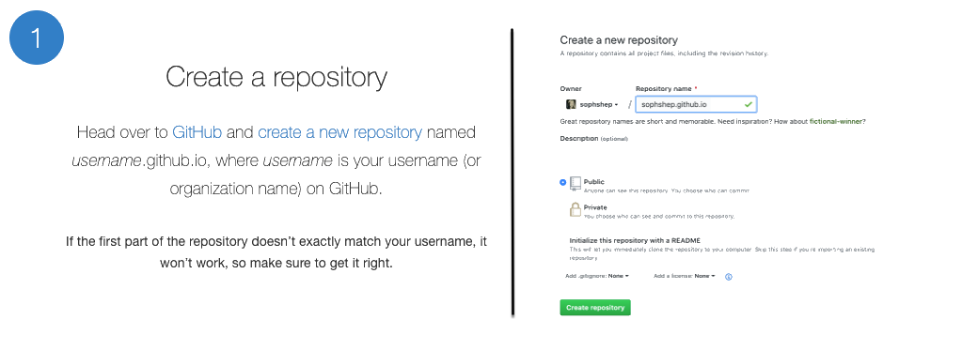
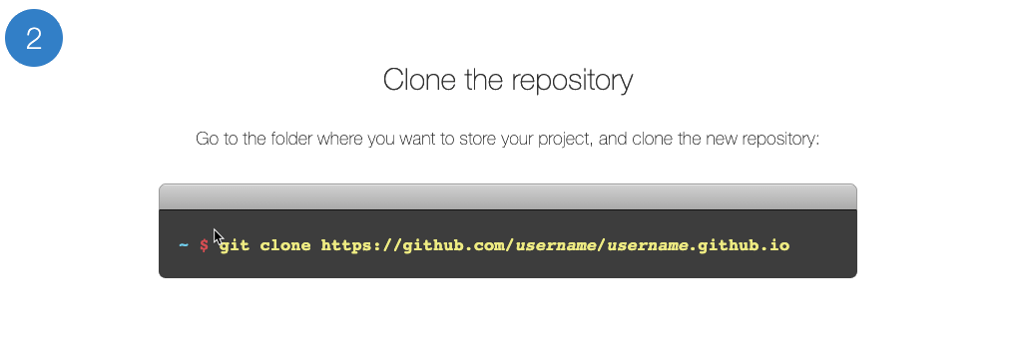
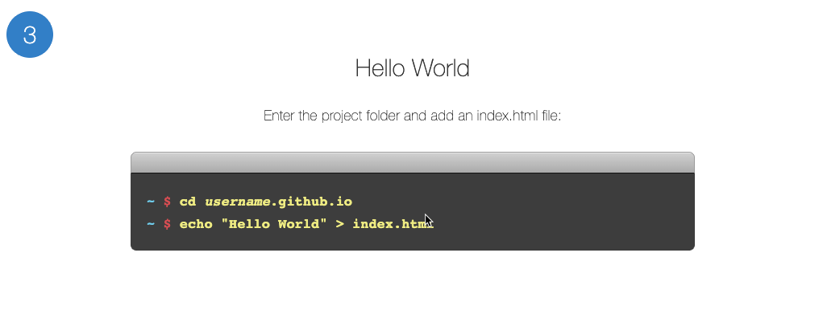
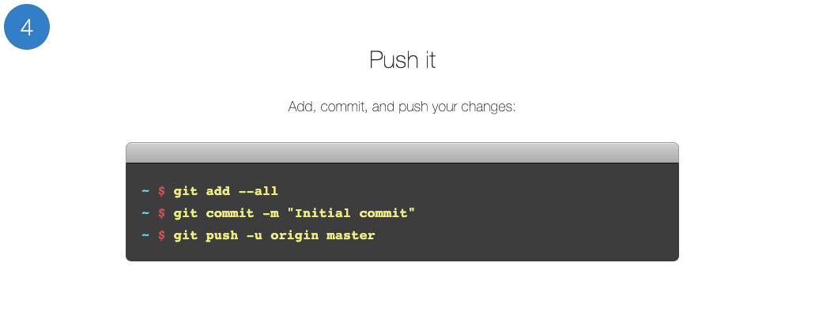
Deploying to GitHub Pages - Personal
Notes:
2.1
Open up the GitHub Pages website and explain how it essentially allows us to turn GitHub repositories into live webpages without having to worry about pushing our code to another web host provider.
GitHub Pages even boasts about how it can turn simple text documents into live websites using a built-in system called "Jekyll"... We will not be using this at the moment but it is very cool. Your students may want to look into it at some point in the future.
GitHub Pages also allows you to create personal/organization sites for your account OR sites that are specific to a project! We will be going over both methods.
Walk through the steps of creating a personal website using GitHub Pages...
Create a new repository on GitHub called "username.github.io" where username is your account name on GitHub.
Next, open up Git Bash or Terminal on your computer. Navigate into the folder that you would like to store your project in and then clone the repository you just created.
Within this new folder, add an HTML file called "index.html" which contains the code for the website you would like to publish.
Add, commit, and push your changes to the repository and... That's it! Whenever anyone navigates to "username.github.io" they will now land on your webpage!
Navigate to the website on your browser to show your class that the webpage is now fully online.
Recap the steps for deploying to GitHub Pages one more time before continuing onto the next activity.
New repo that is labeled "username.github.io".
Navigate into a folder and clone the repo into it
Add an HTML file named "index.html" and code out your webpage
Add, commit, and push your changes into the repository
Go to the settings tab in the repo and scroll down to GitHub pages to confirm the page was published.
Finally click the link or navigate to https://_username_.github.io to visit the webpage.

Slide 9
Activity: Deploying Personal Bios to GitHub Pages
In this activity, you will be deploying the bio pages you created on the previous activity to GitHub pages.
10 Minutes
Notes:
2.2

Slide 10
Activity: Deploying Personal Bios to GitHub Pages
Instructions:
Now that we have gone over how to create a personal website using GitHub Pages, it is your turn to publish the bio you created!
Once your personal webpage is live, slack it out so that everyone can see what you have made.
Deploy Guide:
Create a new repository that is named username.github.io
Navigate into a folder and clone the repository into it
Add an HTML file named index.html and code out a basic webpage (or use a previous page)
Add, commit, and push your changes into the repository
Navigate to username.github.io and you will find that your new web page has gone live!
Bonuses:
Add a few new pages to your website
Add extra tags and flesh your page out some more - give it some pop
Notes:
2.2

Slide 11
Deploying to GitHub Pages - Projects
Notes:
3.1

Slide 12
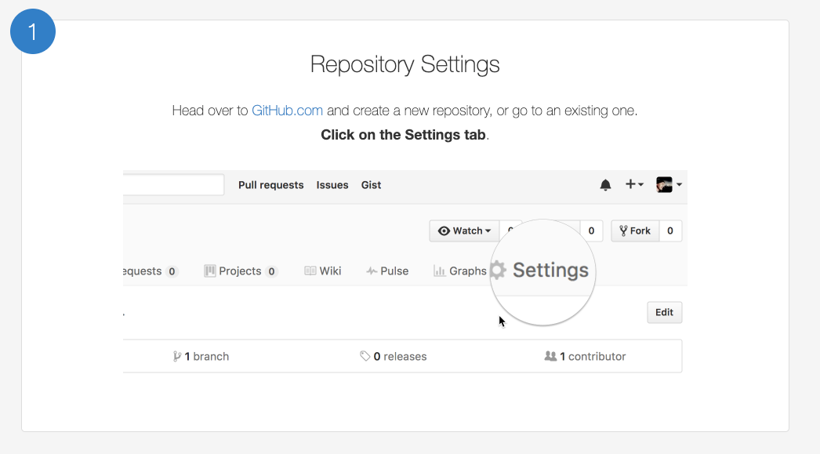
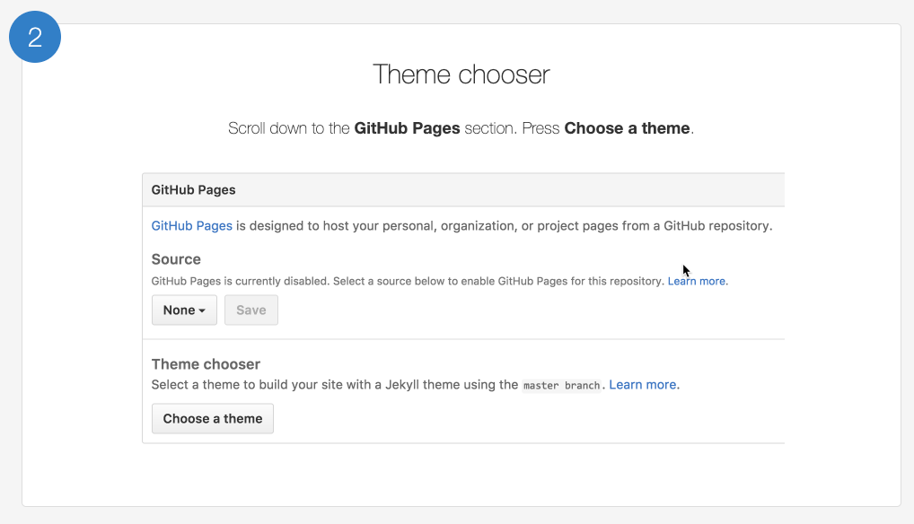
Deploying to GitHub Pages - Projects
Notes:
3.1
Not every website can be a personal website, however, as there are many times in which we will want to create websites that are customized for specific projects. Luckily for us, GitHub Pages includes a VERY simple way to deploy webpages for individual projects as well!
Walk through the steps required to create a website for a specific repository...
Create a new repository on your GitHub account. You can name this repository whatever you would like.
Once inside of the repository, create a new file and name it "index.html"
Add some very basic HTML into this file, save it, and then navigate into your repository's Settings tab.
Scroll down to the GitHub Pages section and then, in the section labeled "Source", select that you would like to use the master branch as your source.
Navigate to "username.github.io/repositoryname" and you will find that your new web page has gone live!
It is very likely that your students will be wondering how to get a custom domain for their projects as opposed to a site that is clearly linked to their GitHub account...
Mention that custom domains are more heavily coveted since they are more easily searchable online. This means that custom domains have to be purchased from companies known as "DNS Providers". These companies allow users to buy and register unique domain names and connect that name to an IP address. GitHub Pages does not sell domain names.
Tell your students not to worry about custom domains at this time since it is not necessary for the web work that we will be doing. If they really wish to link a webpage of theirs to a custom domain, however, GitHub Pages has great documentation on how to go about doing this

Slide 13
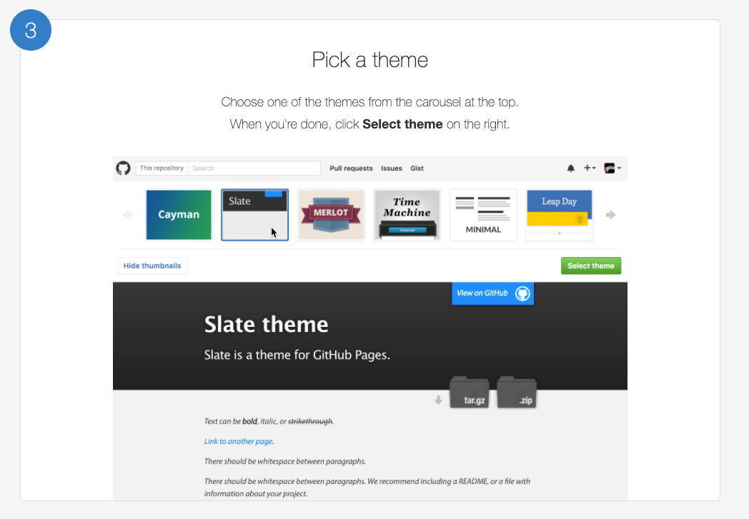
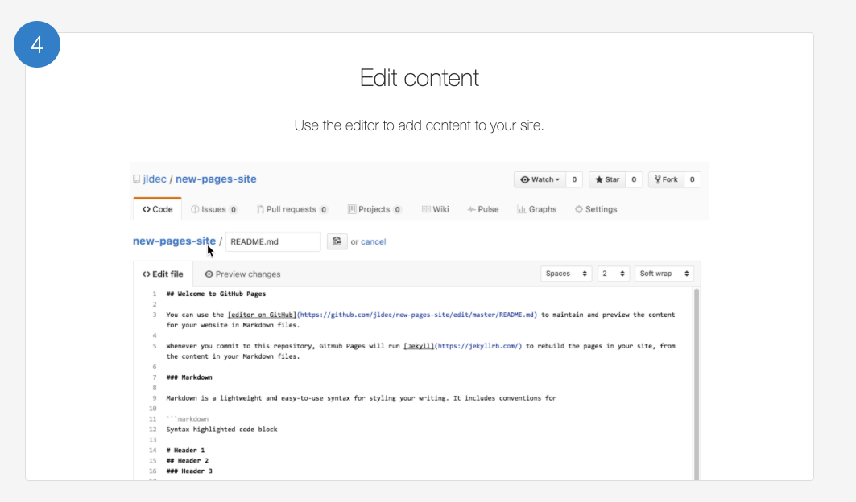
Deploying to GitHub Pages - Projects
Notes:
3.1
Not every website can be a personal website, however, as there are many times in which we will want to create websites that are customized for specific projects. Luckily for us, GitHub Pages includes a VERY simple way to deploy webpages for individual projects as well!
Walk through the steps required to create a website for a specific repository...
Create a new repository on your GitHub account. You can name this repository whatever you would like.
Once inside of the repository, create a new file and name it "index.html"
Add some very basic HTML into this file, save it, and then navigate into your repository's Settings tab.
Scroll down to the GitHub Pages section and then, in the section labeled "Source", select that you would like to use the master branch as your source.
Navigate to "username.github.io/repositoryname" and you will find that your new web page has gone live!
It is very likely that your students will be wondering how to get a custom domain for their projects as opposed to a site that is clearly linked to their GitHub account...
Mention that custom domains are more heavily coveted since they are more easily searchable online. This means that custom domains have to be purchased from companies known as "DNS Providers". These companies allow users to buy and register unique domain names and connect that name to an IP address. GitHub Pages does not sell domain names.
Tell your students not to worry about custom domains at this time since it is not necessary for the web work that we will be doing. If they really wish to link a webpage of theirs to a custom domain, however, GitHub Pages has great documentation on how to go about doing this

Slide 14
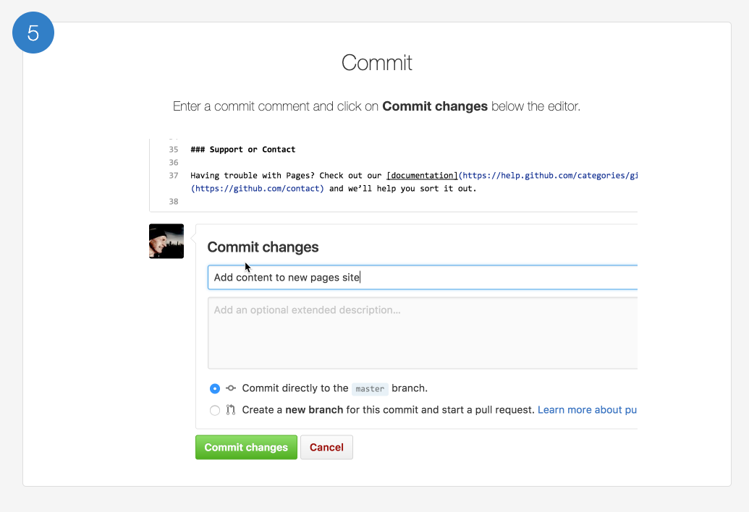
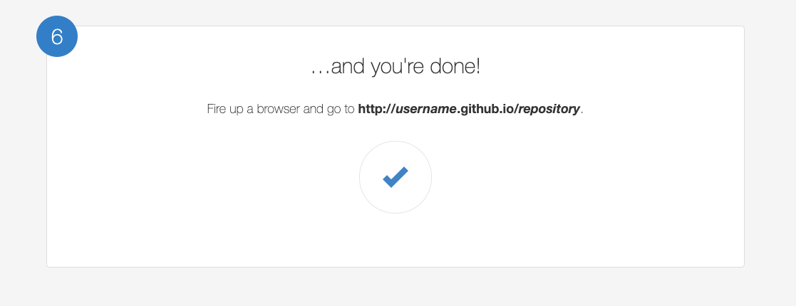
Deploying to GitHub Pages - Projects
Notes:
3.1
Not every website can be a personal website, however, as there are many times in which we will want to create websites that are customized for specific projects. Luckily for us, GitHub Pages includes a VERY simple way to deploy webpages for individual projects as well!
Walk through the steps required to create a website for a specific repository...
Create a new repository on your GitHub account. You can name this repository whatever you would like.
Once inside of the repository, create a new file and name it "index.html"
Add some very basic HTML into this file, save it, and then navigate into your repository's Settings tab.
Scroll down to the GitHub Pages section and then, in the section labeled "Source", select that you would like to use the master branch as your source.
Navigate to "username.github.io/repositoryname" and you will find that your new web page has gone live!
It is very likely that your students will be wondering how to get a custom domain for their projects as opposed to a site that is clearly linked to their GitHub account...
Mention that custom domains are more heavily coveted since they are more easily searchable online. This means that custom domains have to be purchased from companies known as "DNS Providers". These companies allow users to buy and register unique domain names and connect that name to an IP address. GitHub Pages does not sell domain names.
Tell your students not to worry about custom domains at this time since it is not necessary for the web work that we will be doing. If they really wish to link a webpage of theirs to a custom domain, however, GitHub Pages has great documentation on how to go about doing this

Slide 15
Activity: Creating a Project Site
In this activity, you will be creating a web page to display and explain a data science project you already completed and will deploy the HTML to a github pages project page.
10 Minutes
Notes:
3.2

Slide 16
Activity: Deploying Personal Bios to GitHub Pages
Instructions:
Now that you know how to create webpages for specific projects, navigate into the repository of one of your previous activities or homework assignments and create a basic webpage for that project.
Make a simple website that explains what the purpose of the activity was and shows off some of the work that you have done.
Create a header that will act as a title for the page
Create a few short paragraphs describing the project's purpose
Try to include at least one table or a picture of a graph that shows off some of the data you collected
Have some fun! Test your HTML skills by going above and beyond with your page!
Once you have created your HTML, add, commit, and push your files up to GitHub Pages.
Make sure to navigate to your page in the web browser to ensure your website is live.
Notes:
3.2

Slide 17
Activity: Deploying Personal Bios to GitHub Pages
Deployment Guide:
Create a new repository on your GitHub account. You can name this repository whatever you would like.
Once inside of the repository, create a new file and name it index.html
Add your HTML into this file, save it, and then navigate into your repository's Settings tab.
Scroll down to the GitHub Pages section and then, in the section labeled Source, select that you would like to use the master branch as your source.
Navigate to username.github.io/repositoryname and you will find that your new web page has gone live!
Bonuses:
Try to create a navigation system which links from your personal website to this new project site and vice-versa.
See if you can create something of a portfolio that can be used to show off all of the work you have done in the past.
Notes:
3.2

Slide 18

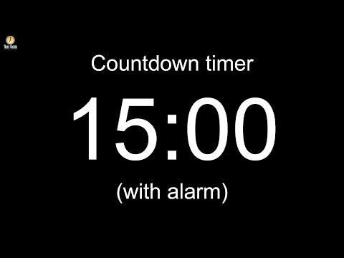
Notes:
-------------------
Image source: AdobeStock_56885471

Slide 19
Introduction to Basic CSS Styling
Notes:
4.1

Slide 20

Introduction to Basic CSS Styling
CSS: Cascading Style Sheets
CSS describes how and where elements should appear on the page. It defines things such as color, placement, fonts, sizes, and more.
Notes:
4.1
Congratulations! We now know how to make our web pages live for the entire world to see! That's pretty awesome! Well... Maybe minus the "pretty" part, at least. Our sites are still very basic looking. So how do we go about making our webpages look better?
Luckily for us, another web development language was developed to work alongside HTML for exactly this purpose: CSS.
CSS stands for "Cascading Style Sheets" and it is a computer language which is used to "format" HTML. In simpler terms, CSS is a presentation language which tells web browsers how the content of a particular page should look.
While HTML was developed to describe the content of a webpage, CSS was developed to present what that content should look like.

Slide 21


Introduction to Basic CSS Styling
HTML/CSS Analogy
HTML Alone | HTML and CSS
Like writing papers in Notepad. | Like writing papers in Microsoft Word.
Used to write unformatted text (i.e, content only). | Used both to write the content and format it (color, font, alignment, layout, etc.).
Notes:
4.1

Slide 22
Introduction to Basic CSS Styling
CSS Syntax
CSS works by hooking onto selectors added into HTML using classes and identifiers.
Once hooked, we apply styles to those HTML elements using CSS.
selector
property
value
declaration end
a
{
background-color
:
yellow
;
}
declaration start
property/value separator
declaration separator
Notes:
4.1

Slide 23
Notes:
4.2
When prompted by the slide deck, create a new HTML file and show the class some examples of how CSS can be used to change a page's styling.
Stick with very simple styling for now! Show your class how to change coloring, size, font boldness/italics, and alignment. We will delve into more complex CSS styling soon enough.
An example of an HTML page with some CSS styling has been provided within 04-BasicCSS for you to use, but it is recommended that you live code all of the CSS so that your students get a good example of its usage.
The same file minus the CSS styling can be found in 04-BasicCSS as well.
To start, alter the style of the page within a pair of <style> tags that are contained within the HTML file.
Show them how you can create a "stylesheet" which contains CSS rules that can then be applied to multiple tags/elements.
Make certain to point out the syntax of CSS once more
Selector points to the HTML element you would like to style
Declaration blocks are bounded by curly-brackets
Each declaration block is separated by semicolons
Each declaration includes a CSS property and a value that is separated by a colon
Explain and show your students how they can also change the style of specific elements within the HTML tags themselves using "inline styling".
Point out that this is more tedious than just having a separate stylesheet, as inline styling applies only to the individual tags the style="" attribute is placed inside. It also takes away the benefits you get from having your content and presentation separate from one another, making the code that much harder to maintain.
Once you have described the syntax of CSS and shown off how CSS stylesheets work, open up a new file, save it as stylesheet.CSS, place all of the CSS you have written into this file, and then explain how you can reference external stylesheets in HTML using a <link> tag.
Ask the class why it might be better to have an external stylesheet as opposed to having all of your CSS styling contained within the HTML file.
External stylesheets can be changed out more easily than having to rewrite every CSS rule

Slide 24
Activity: Dull Corp
In this activity, you will be updating the DULL Corporation’s website so that it is not nearly so...Dull. To do so, you will be creating an external stylesheet and linking it to pre-made HTML.
10 Minutes
Notes:
4.3

Slide 25
Activity: Dull Corp
Instructions:
Open the Unsolved Starter.
Using external CSS and your imagination, update the "DULL Corp" website to be more interesting.
Center the header element to the page.
Set each h1,h2, and h3 element to be a different color.
Set img element to have a shadow.
Give the section element a background color.
Change the font size of both paragraph elements.
Place a border around the ul element.
Notes:
4.3

Slide 26
Notes:
4.4 Check lesson plan
OR
Open up the solution file and go over the code contained within with your class.
Answer whatever questions your students may have before moving onto the next activity

Slide 27
Classes, IDs, and Divs
Notes:
5.1

Slide 28
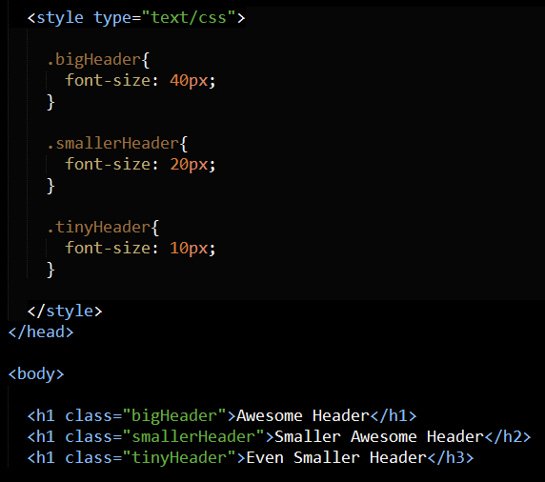
Classes, IDs, and Divs
HTML class
To create an HTML class, place a class=”((className))”
Notes:
5.1
Explain to the class why changing entire HTML elements may not exactly be the best practice.
If we were to have a CSS rule that applies to all paragraph tags, then all of our paragraphs would look the same. What if we wanted one to look differently from another?
Luckily there are HTML classes and ids which allow us to pick and choose which HTML elements we want to style in particular ways.
To create an HTML class, place a class="((className))" attribute within an HTML element. To reference that class within the CSS, simply put a period in front of className in your stylesheet.

Slide 29
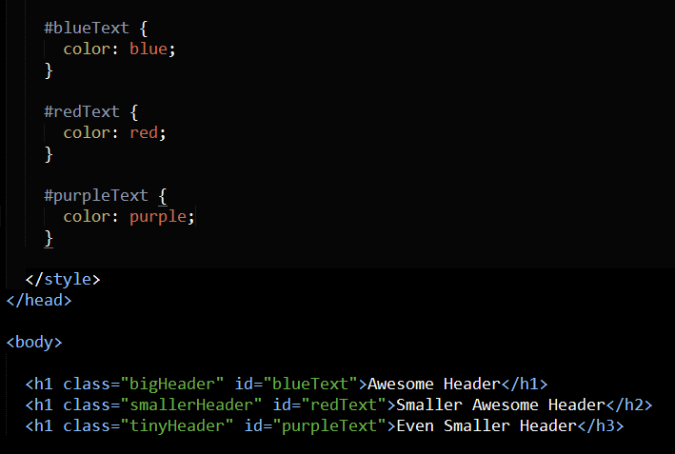
Classes, IDs, and Divs
HTML id
To create an HTML id, place an id="((idName))" attribute within an HTML element.
Notes:
5.1
To create an HTML id, place a id="((idName))" attribute within an HTML element. To reference that id within the CSS, simply put a hashtag in front of idName in your stylesheet.
As a callback to the previous class, ask your students what the differences between a div element and a section element are.
Explain that div elements are used to group elements into visually related segments while section elements define a specific part of a page and thus should be used as a container element regardless of styling.
Container elements like div and section, combined with classes and ids, allow users to group and style HTML elements in chunks. This is especially useful in positioning.

Slide 30
Activity: Targeted CSS
In this activity, you will be given a very basic HTML file and will have to create an external CSS stylesheet changes the page’s styling.
5 Minutes
Notes:
5.2

Slide 31
Activity: Dull Corp
Instructions:
Open the Unsolved Starter.
Using an external stylesheet, classes, and IDs accomplish the following...
Style the first element so that it has a color of blue
Style the second and third elements so that they have a color of purple
Style the fourth element so that it has a color of red
Bonus
Using only additional classes and IDs, attempt to accomplish the following...
Set the background color of the first and last elements to black
Set the font-size of the first element to 40px
Set the font-weight of the second element to bold
Set the font-size of the third and last elements to 10px
Notes:
5.2

Slide 32
Notes:
5.3 Check lesson plan
OR
Open up the solved version of the previous activity and go through the code with your class, answering whatever questions they may have.

Slide 33
Box Model and CSS Positioning
Notes:
6.1

Slide 34
Box Model and CSS Positioning
Boxes Upon Boxes
In CSS, every elements rests within a series of Boxes.
Each box has customizable space properties: margin, border and padding.
Typical spacing value: 20px 10px 10px 20px (top, right, botton, left).
Margin
Border
Padding
Content
Notes:
6.1
Open up the slide deck once more and continue through the presentation on using CSS to position elements, answering whatever questions the class may have.
After you have gotten through the slide on the box model, open up Google Chrome and show off the HTML/CSS inspector in its developer's tools.
For the time being, specifically focus upon the box-model visualizer.
Once you have covered the inspector, provide your students with some time in which to visit their favorite website and play around with the inspector on that page.
After a small amount of time has passed, continue through the slides once more.

Slide 35
Box Model and CSS Positioning
Position: Static
Box 1
Four boxes placed statically (default):
Box 2
Box 3
Box 4
Notes:
6.1
Open up the slide deck once more and continue through the presentation on using CSS to position elements, answering whatever questions the class may have.
After you have gotten through the slide on the box model, open up Google Chrome and show off the HTML/CSS inspector in its developer's tools.
For the time being, specifically focus upon the box-model visualizer.
Once you have covered the inspector, provide your students with some time in which to visit their favorite website and play around with the inspector on that page.
After a small amount of time has passed, continue through the slides once more.

Slide 36

Box Model and CSS Positioning
Position: Relative
Switching the boxes to relative will nudge the boxes in relation to their “original” location:
Box 1
Box 2
Box 3
Box 4
Notes:
6.1

Slide 37
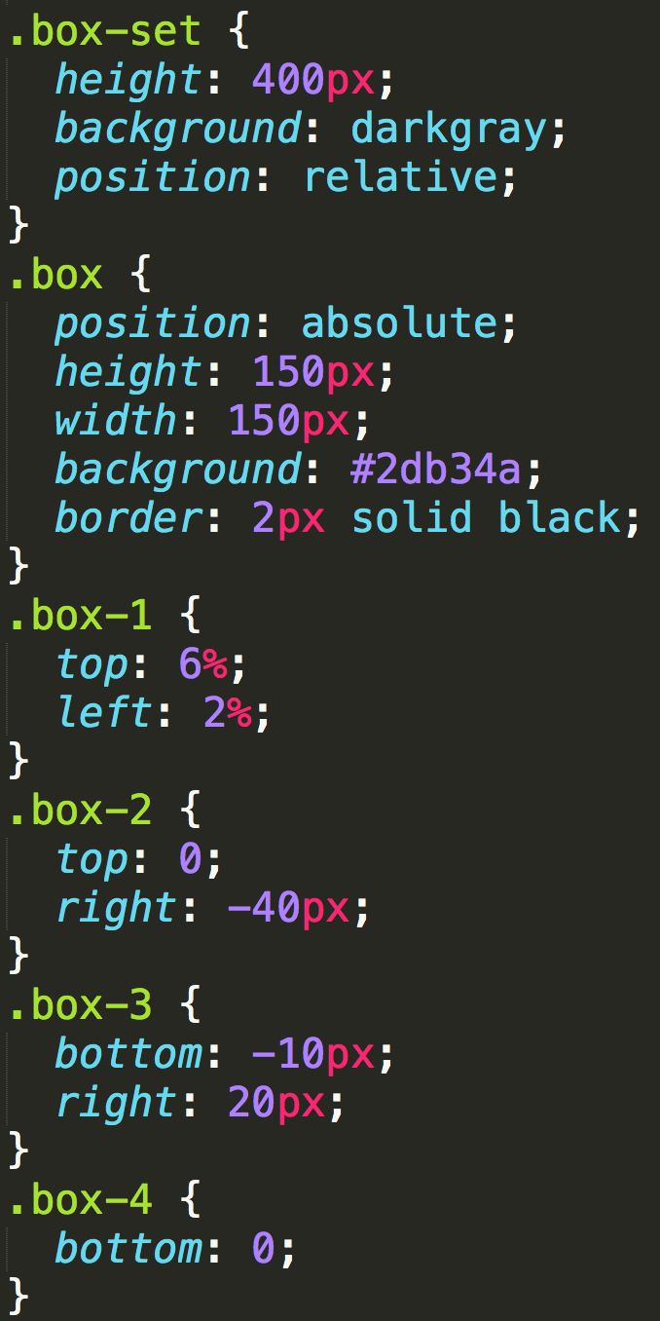
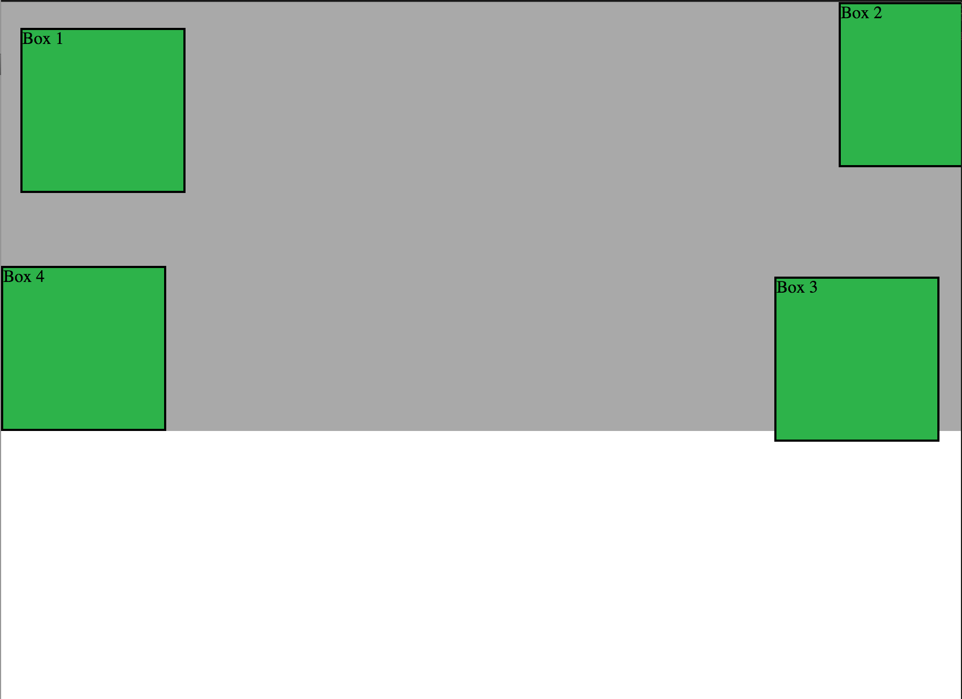
Box Model and CSS Positioning
Position: Absolute
Positioned relative to nearest positioned ancestor:
Notes:
6.1

Slide 38
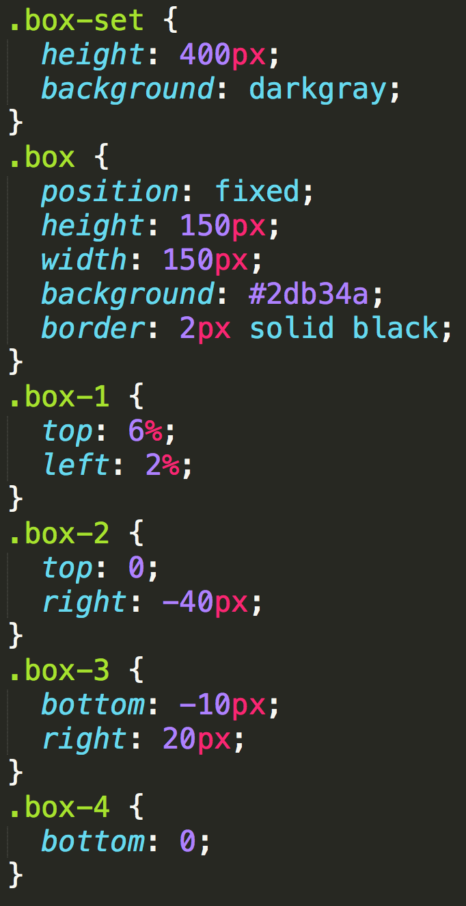
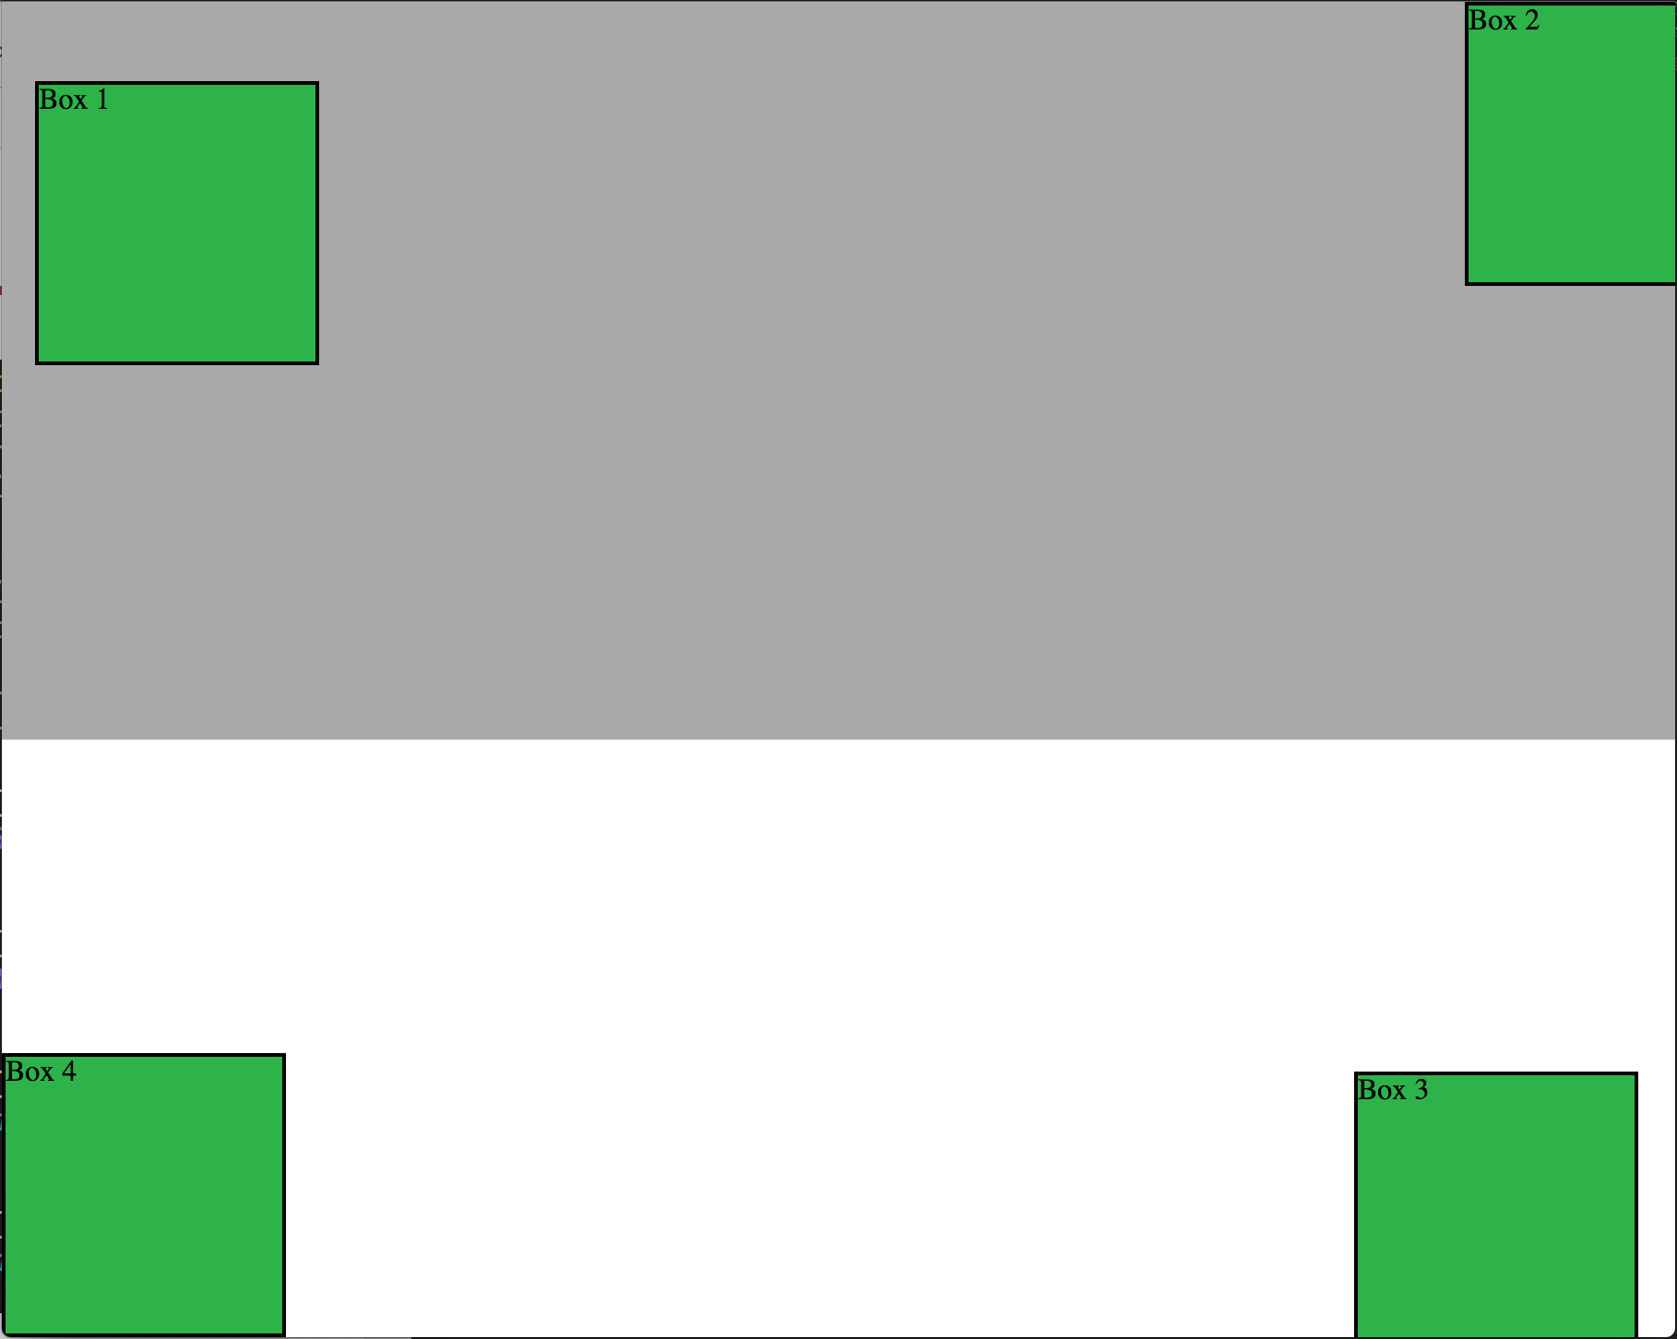
Box Model and CSS Positioning
Position: Fixed
Position with exact coordinates in the browser window:
Notes:
6.1

Slide 39
Box Model and CSS Positioning
Layering with Z-Index
The z-index property allows you to layer elements on top of each other.
position: absolute;
z-index:1;
position: absolute;
z-index:2;
Notes:
6.1

Slide 40
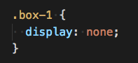
Box Model and CSS Positioning
Hiding things
Display: None allows you to hide elements from view.
This will become useful in later sections, we’ll hide and reveal specific HTML elements of our choosing.
Box 2
Box 3
Box 4
Notes:
6.1

Slide 41
Box Model and CSS Positioning
The concept of Flow
By default, every HTML element displayed in the browser is governed by a concept called flow.
This means that HTML elements force their adjacent elements to flow around them.
Float Left
Float Right
Notes:
6.1

Slide 42
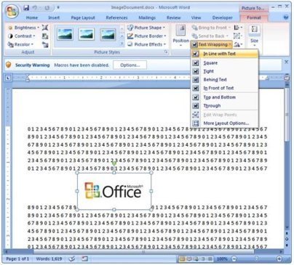
Box Model and CSS Positioning
Flow analogy to MS Word
This concept of “flow” is very similar to the wrap-text options you may be familiar with in Microsoft Word.
Just as in MS Word, you can have images in-line with text, on-top of text, etc.
Notes:
6.1

Slide 43


Box Model and CSS Positioning
Block Elements
By default, web clients render many HTML elements as block elements. Paragraphs, headers, divs, and more receive this treatment.
A block element will take up an entire line of space—unless you intervene with CSS properties.
Block
Notes:
6.1

Slide 44
Box Model and CSS Positioning
Block Elements vs. In-Line Elements
Now, contrast block elements with in-line elements.
By using float CSS properties, we can command our website to display multiple HTML elements adjacently.
In-line
Block
Notes:
6.1

Slide 45
Box Model and CSS Positioning
Floats
To transform these block elements into in-line elements, we use a CSS property called float. Floats are necessary when building web layouts.
css
Header
#sidebar {
float: left;
}
#main-content {
float: right;
}
Sidebar
Main Content
Float Left
Float Right
Footer
Notes:
6.1

Slide 46
Box Model and CSS Positioning
Clearing the Float
However, floats often get in the way of layouts. Sometimes we don’t want to give each element the “in-line” treatment.
Main Content
(float left)
Sidebar
(float right)
Footer (not cleared!)
Notes:
6.1

Slide 47

Box Model and CSS Positioning
Clearfix Hack
Sometimes when elements don’t match up in size, we get situations like this:
<div>
Uh-oh! The image is taller than the element containing it, and it’s floated, so it’s overflowing outside of its container!
Notes:
6.1

Slide 48
Box Model and CSS Positioning
Clearfix Hack
We can get around this by using the clearfix hack.
<div class="clearfix">
Much better!
Notes:
6.1

Slide 49
Box Model and CSS Positioning
Clearfix Hack
::after is what we call a pseudo-element. We use it to style specific parts of an element.
This will add an HTML element, hidden from view, after the content of the .clearfix element. This clears the float.
.clearfix::after {
content: ""; display: block;
clear: both;
}
Notes:
6.1

Slide 50
Activity: Aimed Positioning
In this activity, you will be given an HTML file you will style using CSS. In particular, they will be posting certain elements as described in the instructions.
10 Minutes
Notes:
6.2

Slide 51

Activity: Aimed Positioning
Instructions:
Open the Unsolved Starter.
Using CSS, position the five headers in the starter code in their described locations.
Try to accomplish this using the box model
Try to accomplish this using absolute positioning
Whenever you complete a step, save a unique version of your stylesheet and then create a new stylesheet for the next step.
Hints:
You can move elements around the page using pixels OR percentages. Try out both to see how they work.
Not every task is capable of being accomplished without changing the order of HTML elements. Even then, some positions may still be impossible.
Bonus:
Try to move the HTML elements provided using different kinds of positioning (static, relative, and fixed).
Notes:
6.2

Slide 52
Notes:
6.3 Check lesson plan
OR
Bring the class altogether and then go over the activity once more as a class
Ask the class which method was the easiest and which was the hardest
Ask them if they can see any relative advantages and/or disadvantages to each individual method
Positioning can be used to better place elements without having to move them around in the HTML. They can also be placed on the same line far more easily and, if you use percentages, are more reactive to the viewport's size.
Using the box model alone makes the exact placement of separate elements quite difficult since they cannot easily be placed on the same line.
Using the box model alone to position elements is also heavily frowned upon and should be avoided when possible.
Floats and clears are useful but can be quite difficult to pick up initially. They are more situationally useful than positioning in cases where you would like text to wrap around an element.

Slide 53
Activity: Aimed Positioning
In this activity, you will be given a Bio Page HTML skeleton and it will style it with CSS so the HTML resembles the image provided in the unsolved folder.
20 Minutes
Notes:
7.1

Slide 54
Activity: Aimed Positioning
Instructions:
Open the Unsolved folder and use the files inside as a starting point.
Style the HTML file with the following:
Add a class called "container" on the div tag.
Add an id called "main-bio" for the first section tag.
Add an id called "contact-info" for the second section tag.
Add an id called "bio-image" for the bio image.
Style specs:
body
The background color is #efeee7.
The font used "Georgia", Times New Roman, Times, serif;.
The font color is #333333.
Be sure to zero out the body margins and padding so the page is flush to the top of the page.
header
The background-color is #333333.
Notes:
7.1

Slide 55
Activity: Aimed Positioning
Instructions:
h1
The font color is #eee.
The font size is 28px.
Look at the example on the screen, and eyeball the padding and/or margins and positioning of the text.
Notes:
7.1

Slide 56
Activity: Aimed Positioning
Instructions:
h2
The font size is 24px
Make the container have a width of 1024 pixels, and center it. You do this using margin: 0 auto;.
Make #main-bio, #contact-info, #bio-image all float: left.
Make the #bio-image have a width of 200 pixels.
Be sure to include alt text in all images
#main-bio should have a width of 70%.
Add margins to the image so there is distance between it and the bio text.
#content-info should have a width of 30%.
Adjust the line height so it is 1.5 times the size of the font.
Make the link color #d21034.
#figure should be given relative positioning
#bio-name should use absolute positioning and be placed at the bottom-center of your #bio-image
Notes:
7.1

Slide 57
Activity: Aimed Positioning
Instructions:
Make sure to replace the content inside of the HTML document with your own name, github link, etc.
Stage, commit, and push this new file to GitHub Pages.
Bonus:
Using fixed positioning, attempt to create a footer on your page that will stay positioned at the bottom of the screen even when scrolling.
Underneath the main content of your page, add in a "portfolio" section. Try to make it so that the projects are set up in a kind of grid with two projects per row. Each of the projects should be named with a header, include a relevant image, and have a short paragraph describing the project.
Notes:
7.1

Slide 58
Notes:
7.2 Check lesson plan
OR
Invite some students from the class to share their webpages/code on Slack so that they can show off their work.
Do a walk-through of the code with your class, calling upon students to explain the HTML and CSS to their peers.
If there are any areas where your students are struggling, be sure to recap that area for them briefly so that they can catch up.
Emphasize the following points about the importance of today's material:
Students will be able to build upon the bio and project pages they made today to create an effective portfolio to share with employers.
Students should spend time adapting and customizing these pages to showcase their personal brand and skills throughout the remainder of the program so that they can be employer ready at graduation. Employer ready would be a completed resume and portfolio to send to job opportunities.
In an upcoming Milestone with Career Services, students will be asked to submit their portfolio for review and feedback. At that time Career Services will continue to help develop an employer ready portfolio to showcase skills and abilities. Remember that this is needed to successfully apply to jobs.

